Slide 1
A Slimy Game
Jude M.

Slide 2
Brief Description of “Slimy Game”
“Slimy Game” is a 2D Platformer with some Medroidvania based qualities to it, such as going back to levels to get some items, a focus on exploration while still completing levels and achieving a sense of progression, and the eventual cathartic power trip you’d get when you get powerful enough to sweep through the levels.
The plot goes as such: You are a Royal Slime who lived in the caves on top of a mountain overlooking the forest, when some starships come in and hover over the world, causing devastation by their presence. Your job, as a Royal Slime, is to get to the starships and destroy them, before your home and way of life is destroyed.

Slide 3
Functions and Non-Functions
As for how I expect my game to function at a professional level, I am looking to make a start screen and a main menu to my game. With regards to level selection, while it should have a visual representation, I should also have arrays with which I can call forth levels. In the gameplay itself, I am going to use the arrow keys for movement and the zxc keys as my primary action keys. A pause menu should be implemented.
For what my hardware requirements are, I’m basing this off the next closest game I can base it off: Shantae: Half-Genie Hero. You will need at least a Windows 7 OS (Win. 10 recommended), 2.2Ghz CPU with Hyper-Threading (Intel 2 Core Quad Q6600 @ 2.4Ghz), 2GB RAM (4GB RAM), NVIDIA 330 or equivalent (NVIDIA GeForce GTX 480 or higher), DirectX v.9.0 (DirectX v.11.0), 2GB Storage (3GB Storage)

Slide 4
Business Logistics and Timeline
By November 1st, I should have the following done: Slime player tested to play on a simple platform, as well as a simple pause function. By the 14th, I should have the following done: A start menu and one level, preferably with decent graphical integrity. By December 1st, the following should be done: A boss fight, couple enemies developed, and a map element.
In a more realistic department, this game would have a development cycle of around two years. At the most basic level, a game like this will also cost around $400k to produce. A team of seven with sufficient experience can produce a game like this, with a Director, two Producers, two Designers, a Programmer, and a Composer, though it’s suggested to have two Programmers in sync with one another. Some personnel may play double-duty if they can.

Slide 5

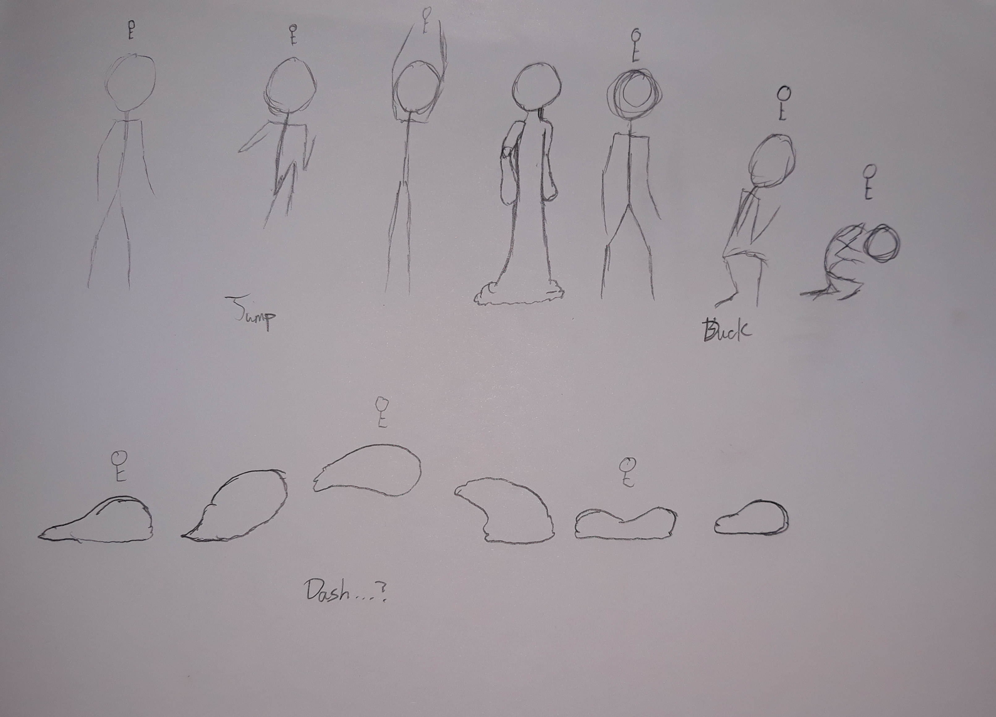
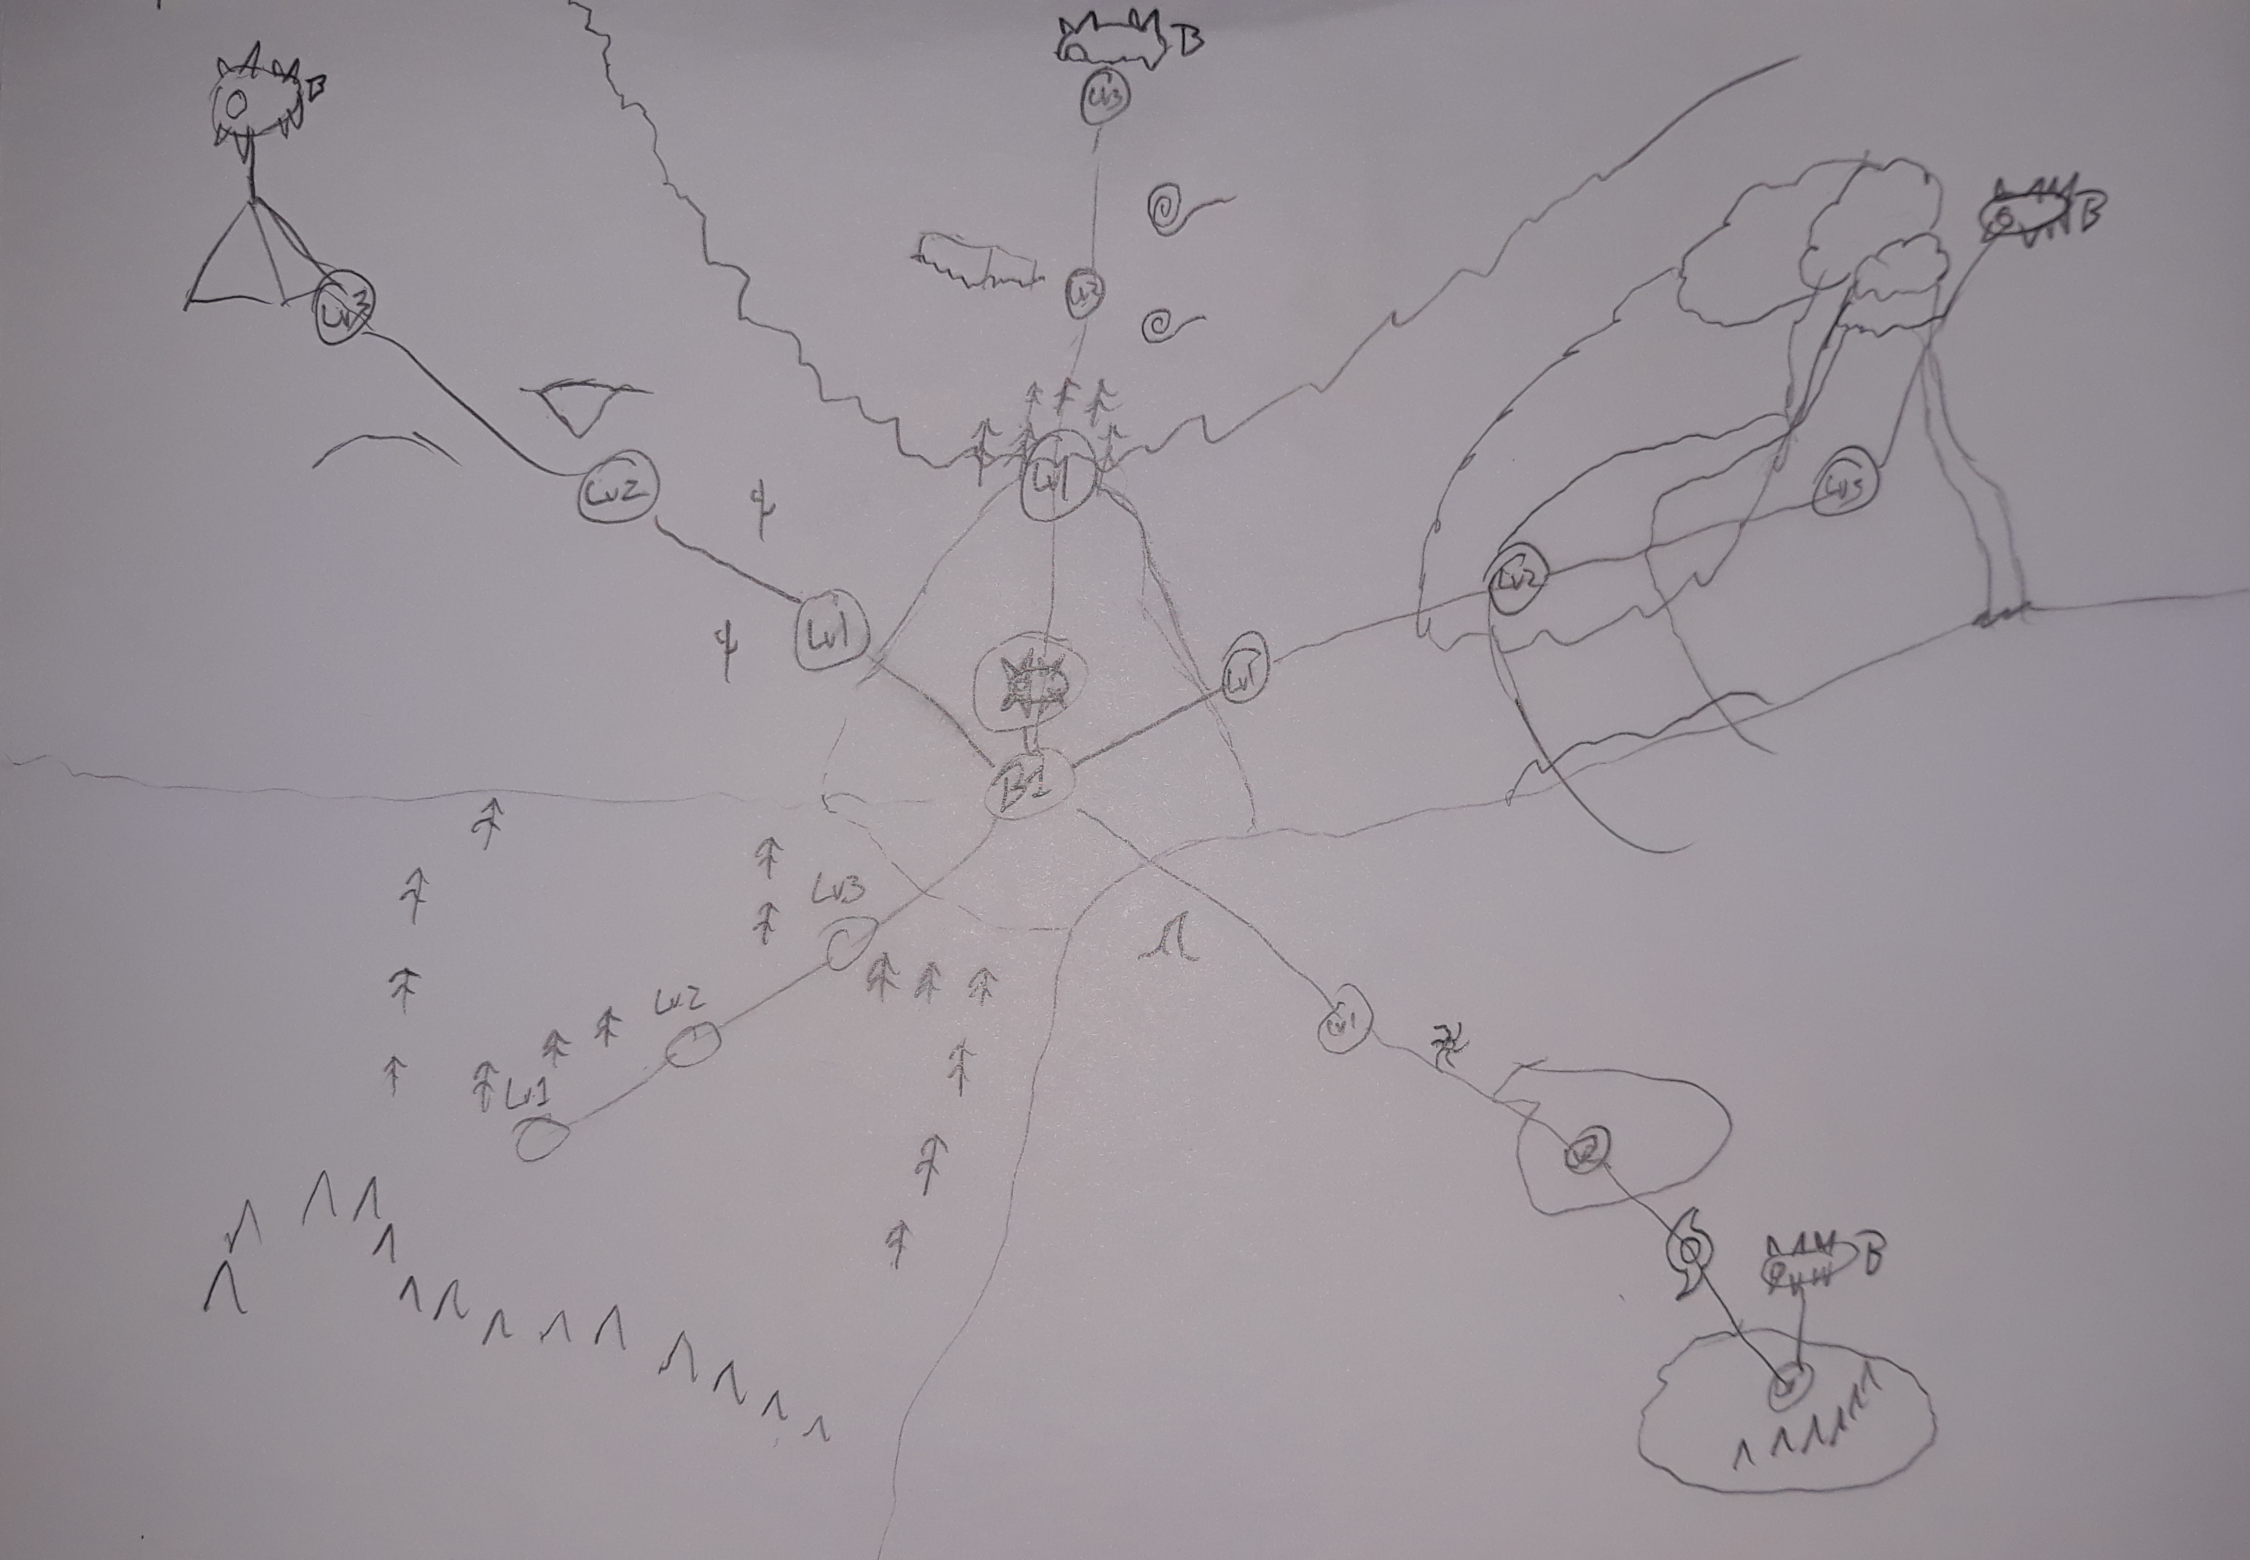
Conceptual Art
As of right now, I have two different pieces of concept art: One for key framing my Slime playable character. Considering their humanoid shape, I am using stick figures as a base for my animation. Below is a mock-up of my map screen, showcasing all the areas you as a play will need to traverse.

Slide 6
Inspirations and Basis
One of my biggest inspirations for this project was down to Matt Bozon’s Shantae games. They aren’t hard-hitting dramas that touch upon issues in our world, such as income inequality or stigma against particular races, but rather just fun, enjoyable experiences with quirky characters and charming visuals and audio. The only remotely dramatic element I am deliberate with using in my game is environmental, though I see this element utilized more in an exaggerated tone. The basis of my games and what I strive to hit in the future is to give people enjoyable experiences, because if a message is pigeonholed into a plot just to be “woke” and it backfires, it’ll cause irreparable damage against the game and reputation of the people making it. However, it is also important to make sure I’m not being deliberate with hurting people, since that also reflects upon my inner self, clear as day. It’s a delicate balance of ethics that will be hard to achieve, especially in a vitriolic period of time such as today’s social-media crazed world and the race to become the loudest idiot of all time.

Slide 7
Last Touch on some Music: The End!
Music is also tonally important for a game like mine, since a good piece of music can and till stay stuck in your memories for years to come. A bad piece of music is like a scent of something bad: in that you get out of dodge like the Grim Reaper’s chasing after you. As for the tone, especially for the forest themed level, I’d want a more wind-based instrumental for the forest, with some more industrial sounds in the background to represent the “corruption” of nature with something more artificial. The boss fight music should reflect a more intense tone, since you’re fighting a boss whose purpose is to kill you and take over the forest (and your world). The sound I would want for my Slime is a more wet, goopy kind of sound (likely needs to be Follie.)
All in all, while Game Engines (this class) deals with the engineering and programming aspects of games, games as a whole are like film: they’re pieces of art that requires multiple artists with different principles and skills coming together to create something that can often be more than the sum of their individual parts. If a designer is failing their part, the product often sinks. The same can be said for a sound designer, a composer, or the directors/producers.

